Slide 1



UNIVERSITY INSTITUTE OF ENGINEERING
COMPUTER SCIENCE ENGINEERING
Bachelor of Engineering
Cloud Computing(CST-411)
Prepared By: ER .NEETU BALA(E15382)
Topic :Cloud Computing Content
DISCOVER . LEARN . EMPOWER

Slide 2
Course Objectives
To provide an understanding of the fundamental concepts and principles of cloud computing.
To familiarize students with different cloud deployment models and their characteristics.
To explore various cloud service models and their applications.
To develop skills in deploying and managing applications on cloud platforms.
To introduce students to the security challenges and solutions in cloud computing.
To examine scalability and performance optimization techniques in cloud environments.
To discuss emerging trends and future directions in cloud computing.

Slide 3
Course Outcomes
CO1 | To Understand the components of cloud computing and its business perspective.
CO2 | Classify the various cloud development tools.
CO3 | Collaborate with real time cloud services.
CO4 | Analyse the case studies to derive the best practice model to apply when developing and deploying cloud based applications.
CO5 | Evaluate cloud providers and perform risk assessment and review, focusing on risk assessment

Slide 4
Syllabus For Unit 1
Unit-1 | Introduction to Cloud Computing | Contact Hours: 15
 | Chapter1: Introduction and history of cloud computing, Characteristics and advantages of cloud computing, Cloud service providers and market overview, Virtualization and its role in cloud computing. Cloud Deployment Models: Public, private, and hybrid cloud models, Comparisons and selection criteria for deployment models, Case studies and examples of cloud deployments.

Slide 5
Detailed overview of Unit 1 Sub Topics
What is Cloud Computing
Why Cloud Computing?
Characteristics of Cloud Computing
Advantages, Disadvantages of Cloud Computing
History of Cloud Computing
Cloud Computing Architecture
Cloud Computing Technologies

Slide 6
Cloud Hypervisor
Advantages of Hypervisor
Types of Hypervisors in Cloud Computing
Type I Hypervisor
Type II Hypervisor
Hypervisors, their use, and Importance
The Evolution of Hypervisors
Why use a hypervisor?
Need of a Virtualization Management Tool

Slide 7
Virtualization includes:
Main Topics
Hardware virtualization
Server virtualization
Storage virtualization
Operating system virtualization
Data Virtualization
its role in cloud computing.
Service-Oriented Architecture (SOA)
Grid Computing
Utility Computing
Difference between Cloud Computing and Grid Computing
How does cloud computing work
Cloud Computing Applications

Slide 8
What are the Security Risks of Cloud Computing
Cloud service providers (Companies)
1. Amazon Web Services (AWS)
2. Microsoft Azure
3. Google Cloud Platform
4. IBM Cloud Services
5. VMware Cloud
6. Oracle cloud
7. Red Hat
8. Digital Ocean
9. Rack space
10. Alibaba Cloud
Data Loss
Hacked Interfaces and Insecure APIs
Data Breach
Vendor lock-in
Increased complexity strains IT staff
Denial of Service (DoS) attacks
Account hijacking

Slide 9
Cloud Deployment Models (Types of Cloud)
Public Cloud
Advantages, Disadvantages of Public Cloud
Private Cloud
Advantages, Disadvantages of Private Cloud
Hybrid Cloud
Advantages, Disadvantages of Hybrid Cloud
Community Cloud
Advantages, Disadvantages of Hybrid Cloud
Difference between public cloud, private cloud, hybrid cloud, and community cloud
Case studies of these models.

Slide 10
Syllabus For Unit II
Unit-2 | Cloud Service Models and Security | Contact Hours: 15
 | Chapter 2: Cloud Service Models: Infrastructure as a Service (IaaS), Platform as a Service (PaaS), Software as a Service (SaaS), Comparison and use cases of service models. Cloud Platform and Tools: Introduction to popular cloud platforms (AWS, Azure, Google Cloud). Security in Cloud Computing, Security challenges and threats in the cloud, Identity and access management, Data privacy and protection, Compliance and legal issues in the cloud

Slide 11
Detailed overview of Unit II Sub Topics
Cloud Service Models :
Infrastructure as a Service (IaaS),
Platform as a Service (PaaS),
Software as a Service (SaaS),
Comparison and use cases of service models.
Cloud Platform and Tools:
Introduction to popular cloud platforms
(AWS, Azure, Google Cloud).
Difference between AWS, Azure, and Google Cloud Platform

Slide 12
Security in Cloud Computing
What is cloud security?
How to manage security in the cloud?
Benefits of Cloud Security System
DDoS Security
Difference between Cloud Security and Traditional IT Security
Advanced Cloud Security Challenges
Cloud Computing Security Architecture
Security Boundaries
Identity and access management
Data privacy and protection
Compliance and legal issues in the cloud

Slide 13
Syllabus For Unit III
Unit-3 | Scaling Techniques and Emerging Trends in Cloud Computing | Contact Hours: 15
 | Chapter1: Scalability and Performance Optimization, Scaling techniques for cloud-based applications. Load balancing and auto-scaling, Performance monitoring and optimization. Chapter2: Emerging Trends in Cloud Computing, Server less computing, Edge computing, Internet of Things (IoT) and cloud integration, Future directions and innovations in cloud computing.

Slide 14
Detailed overview of Unit III Sub Topics
Cloud Scalability
Types of Scalability
Load balancing and auto-scaling.
Performance Optimization
Performance Metrics and KPIs (Key Performance Indicators)
Performance Monitoring Tools and Technologies
Security and Performance Trade-offs

Slide 15
Emerging Trends in Cloud Computing
Edge Computing, Server less Computing
Multi-Cloud and Hybrid Cloud Solutions
Cloud-Native Applications, Kubernetes and Containerization
AI and Machine Learning in the Cloud
Quantum Computing in the Cloud
Cloud Security and Privacy
Internet of Things (IoT) and Cloud Integration
Cloud Governance and Compliance
Cloud Cost Management and Optimization
Cloud-based Big Data and Analytics
Blockchain in Cloud Computing
Green Cloud Computing and Sustainability

Slide 16
Course Evaluation Criteria
For Cloud Computing

Slide 17
Assessment Model (Theory)
Sl No. | Direct Evaluation Instruments | Weightage of actual conduct | Frequency of Task | Final Weightage | Remarks (Graded/ Non-Graded)
1 | Assignment -1 | 10 | 1 | 10 | Graded
2 | Assignment -2 | 10 | 1 |  | Graded
3 | Assignment -3 | 10 | 1 |  | Graded
4 | Mid Semester Test -1 | 20 | 1 | 10 | Graded
5 | Mid Semester Test -2 | 20 | 1 | 10 | Graded

Slide 18
Assessment Model (Theory)
Sl No. | Direct Evaluation Instruments | Weightage of actual conduct | Frequency of Task | Final Weightage | Remarks (Graded/ Non-Graded)
6 | Quiz-1 | 4 | 1 | 4 | Graded
7 | Quiz-2 | 4 | 1 |  | Graded
8 | Quiz-3 | 4 | 1 |  | Graded
9 | Surprise Test-1 | 12 | 1 | 4 | Graded
10 | Surprise Test -2 | 12 | 1 |  | Graded
11 | Surprise Test -3 | 12 | 1 |  | Graded
12 | Attendance | NA | NA | 2 | Graded
13 | End Semester Examination | 60 | 1 | 60 | Graded

Slide 19
MST-1 (Question Paper Format) [20 marks]
Q. No | Statement | Unit No | CO mapping | PI mapping
 | Section A 5 x 2 = 10 marks
1 |  | I
2 |  | I
3 |  | I
4 |  | I
5 |  | I
 | Section B 2 x 5 = 10 marks
6 |  | I
7 |  | I

Slide 20
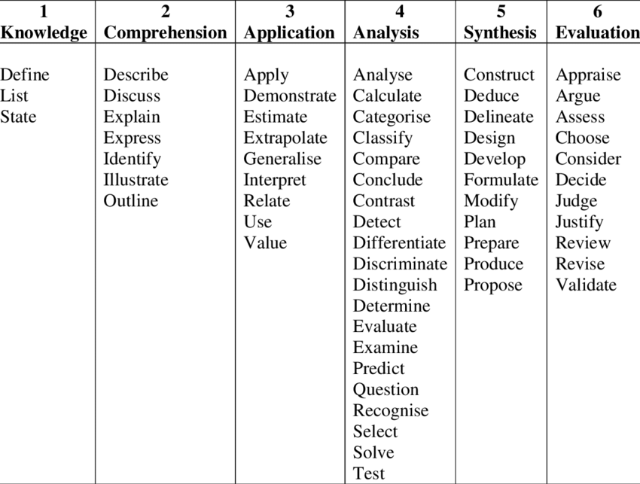
Bloom’s Taxonomy

Slide 21
MST-2 (Question Paper Format) [20 marks]
Q. No | Statement | Unit No | CO mapping | PI mapping
 | Section A 5 x 2 = 10 marks
1 |  | II
2 |  | II
3 |  | II
4 |  | II
5 |  | II
 | Section B 2 x 5 = 10 marks
6 |  | II
7 |  | II

Slide 22
Final Paper(Question Paper Format) 60 marks
Q. No | Statement | Unit | CO mapping | PI Mapping
 | Section A 5 x 2 = 10 marks
1 |  | I
2 |  | II
3 |  | III
4 |  | III
5 |  | III
 | Section B 4 x 5 = 20 marks
6 |  | I
7 |  | II
8 |  | III
9 |  | III
 | Section C 3 x 10 = 30 marks
10 |  | I
11 |  | II
12 |  | III

Slide 23
THANK YOU

